Slide 1
Applied Bionanosensor Array
Dr. Hisham Faiadh Mohammad
PhD Applied nanobiotechnology
HD & MSc Genetic engineering

Slide 2
Contents
Briefly review
Methodology
Application

Slide 3
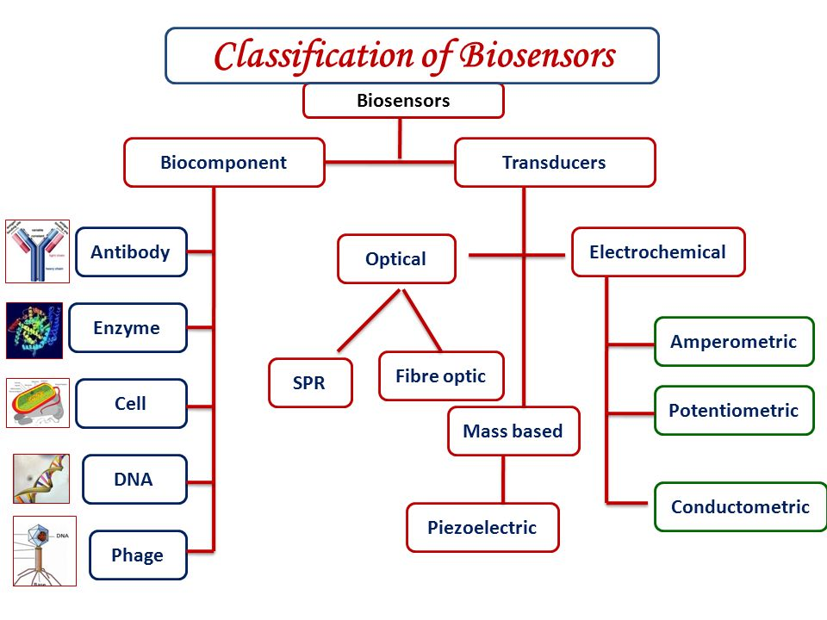
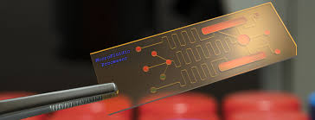
Biosensors and their types
Biosensor is a device for the detection of an analyte that combines a biological component with an electrochemical or physiochemical detector.
Biosensors

Slide 4
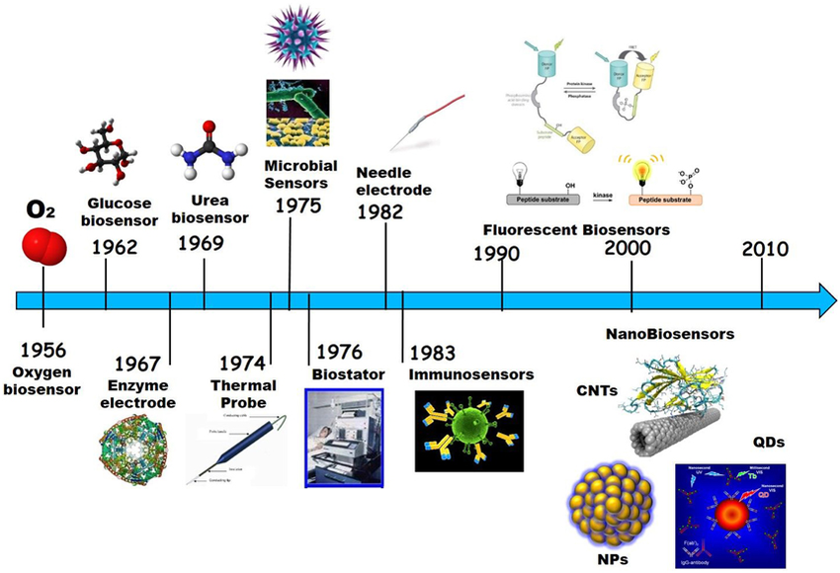
History of Biosensors

Slide 5
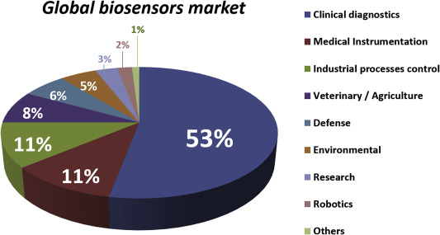
Biosensor Marketing

Slide 6
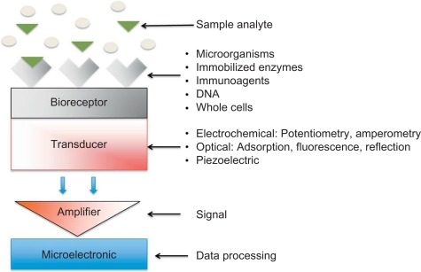
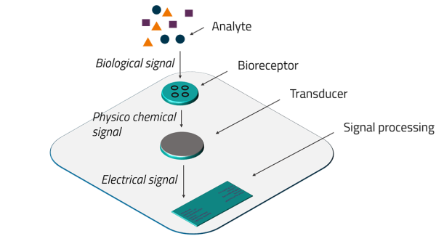
Structure of Biosensor

Slide 7
Biosensor Scenario

Slide 8
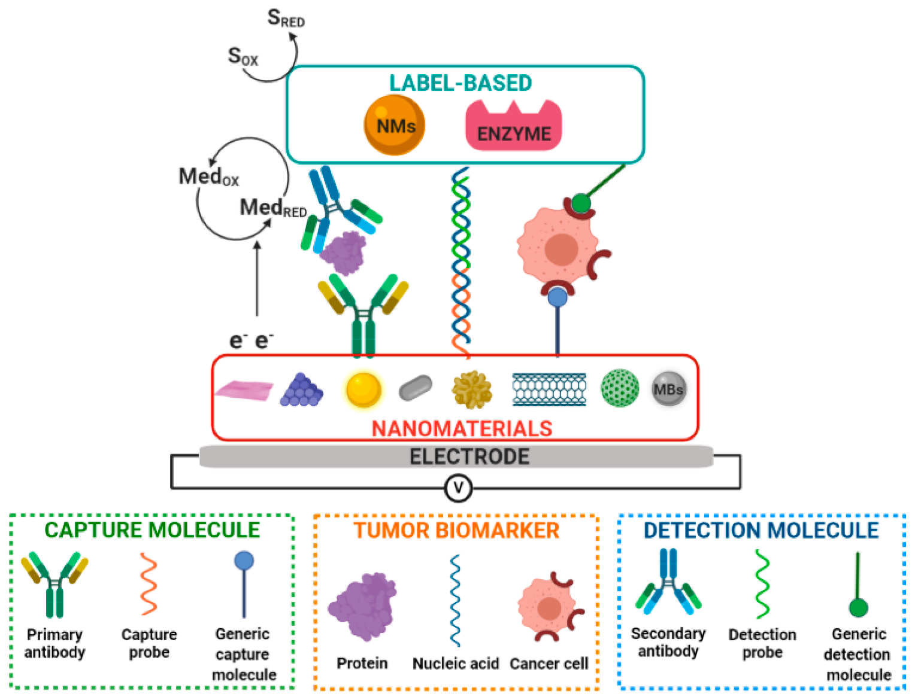
Immobilization protocol

Slide 9
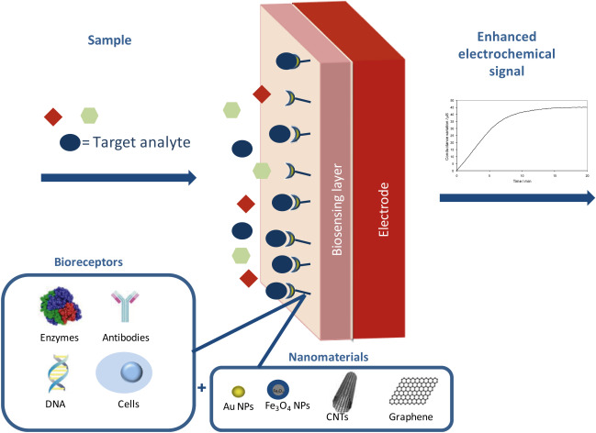
Nanobiosensor

Slide 10
Biosensing Detection Process

Slide 11
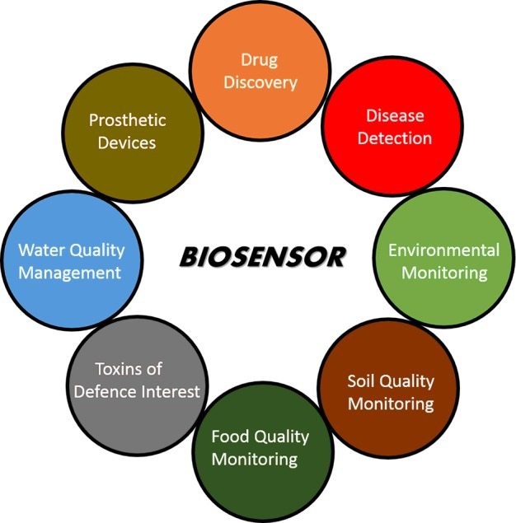
Applications

Slide 12
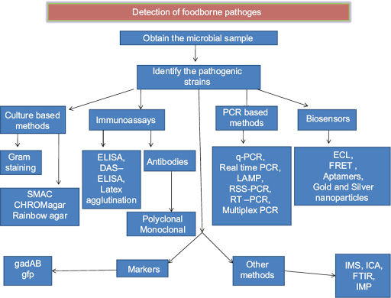
Detection of pathogen

Slide 13
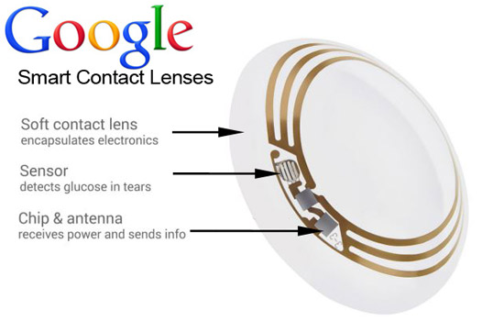
Thank you

